Slide 1
Final Project Testing Log
Test Logs 1-12, with screen recordings to show the system works as directed

Slide 2
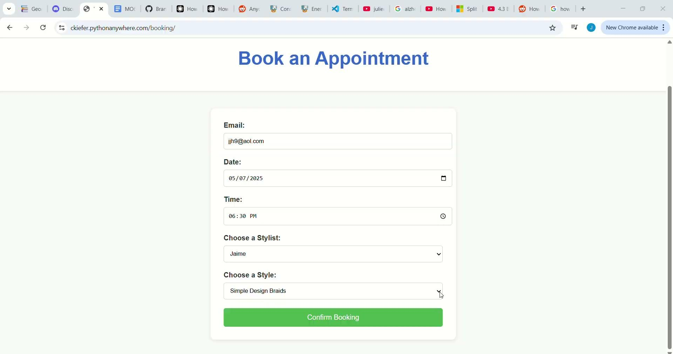
Test Log One
Test Log 1:
Test one had all fields entered and has a recording to the left.
Email: jjh9@aol.com
Date: 5/7/2025
Time: 6:30 PM
Stylist: Jamie
Style: Simple Design Braids

Slide 3
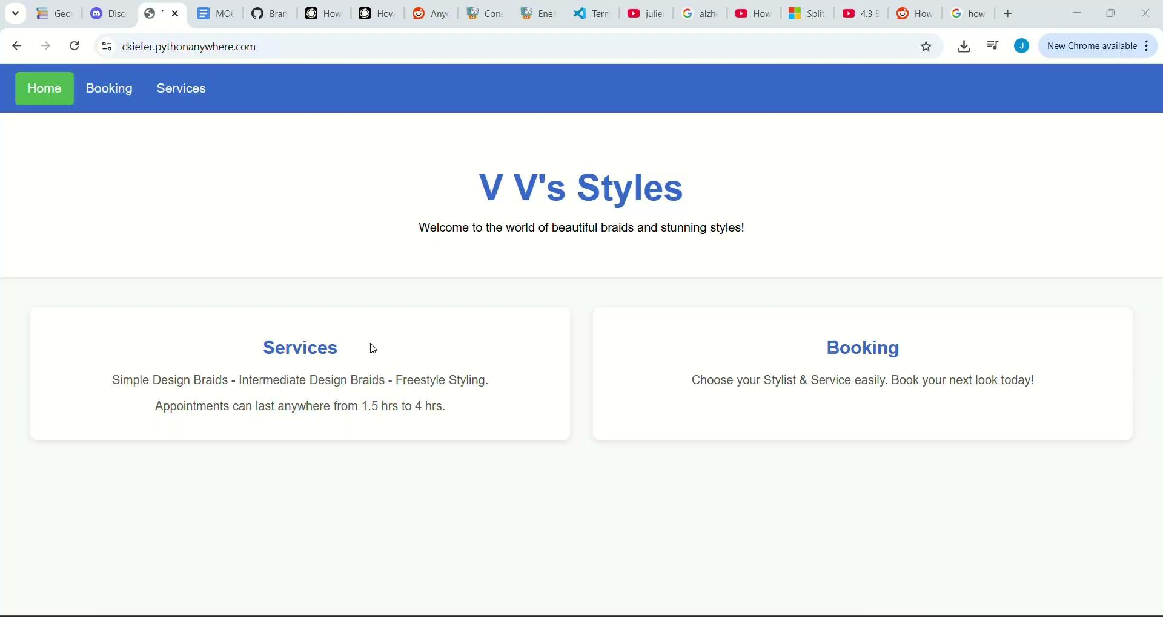
Test Log Two
Test Log Two:
Test Log with all fields entered
Email: snl456@house.org
Date: 5/4/2025
Time: 06:30 PM
Stylist: Luffy
Style: Intermediate Design Braids

Slide 4
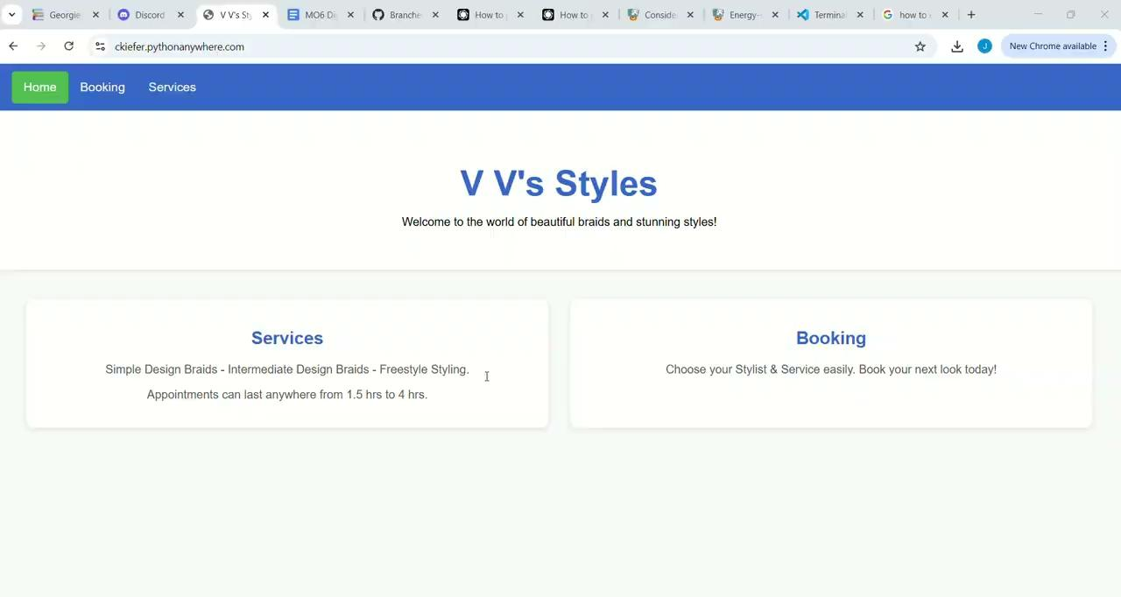
Test Log Three
Test Log 3:
Test with email missing
Email: none
Date: 05/04/2025
Time: 4:00 PM
Stylist: Zoro
Style: Simple Design Braids

Slide 5
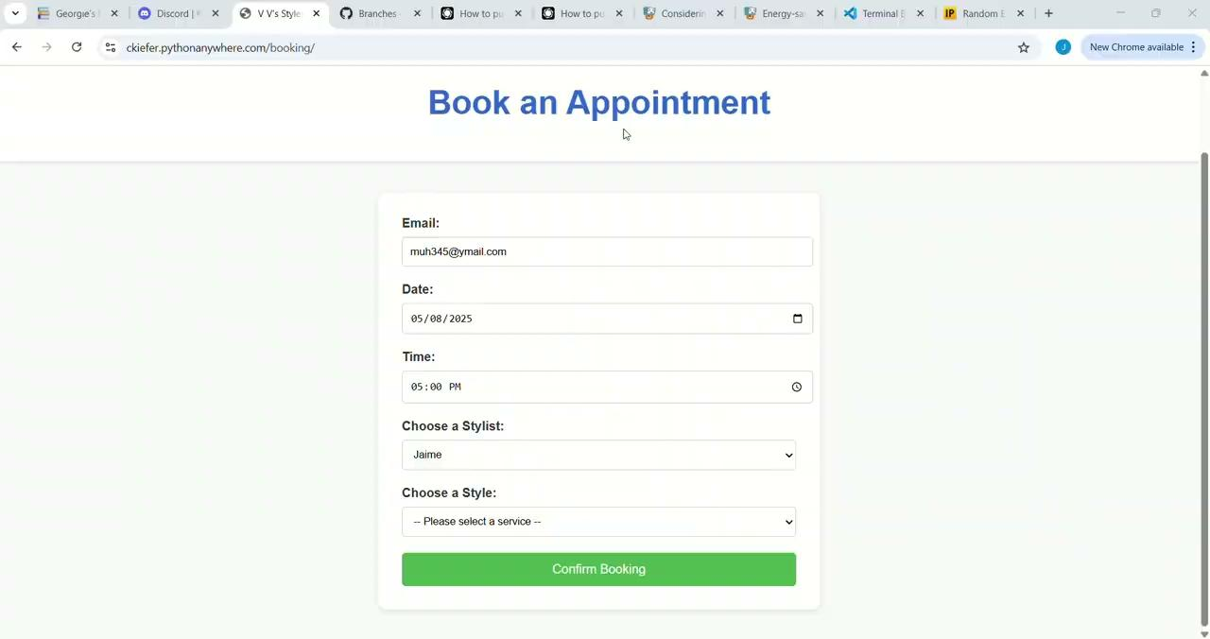
Test Log Four
Test Log Four:
Test with Style Missing
Email: muh345@ymail.com
Date: 5/8/2025
Time: 5:00 PM
Stylist: Jamie
Style: N/A

Slide 6
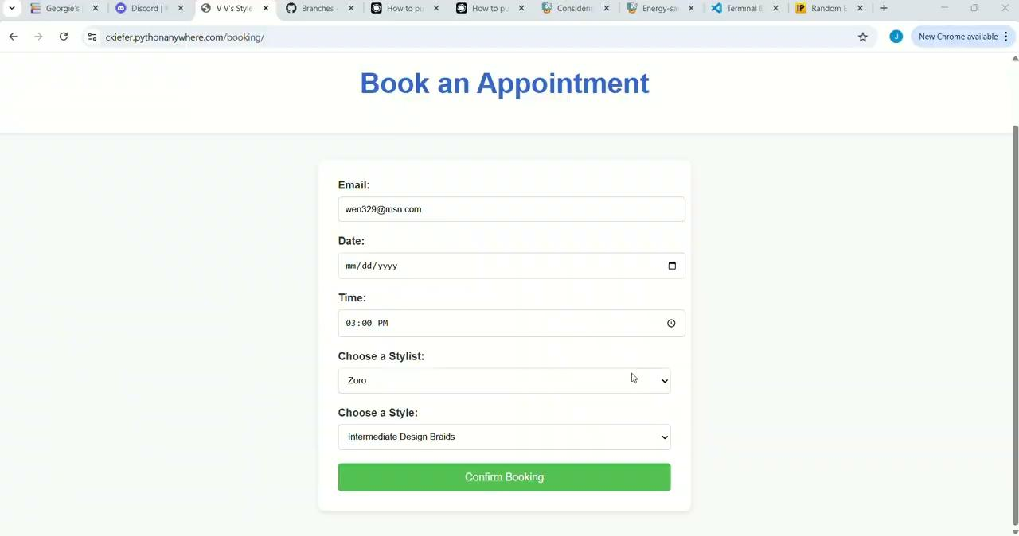
Test Log Five
Test Log Five:
Test with Date Missing
Email: wen329@msn.com
Date:
Time: 3:00 PM
Stylist: Zoro
Style: Intermediate Design Braids

Slide 7
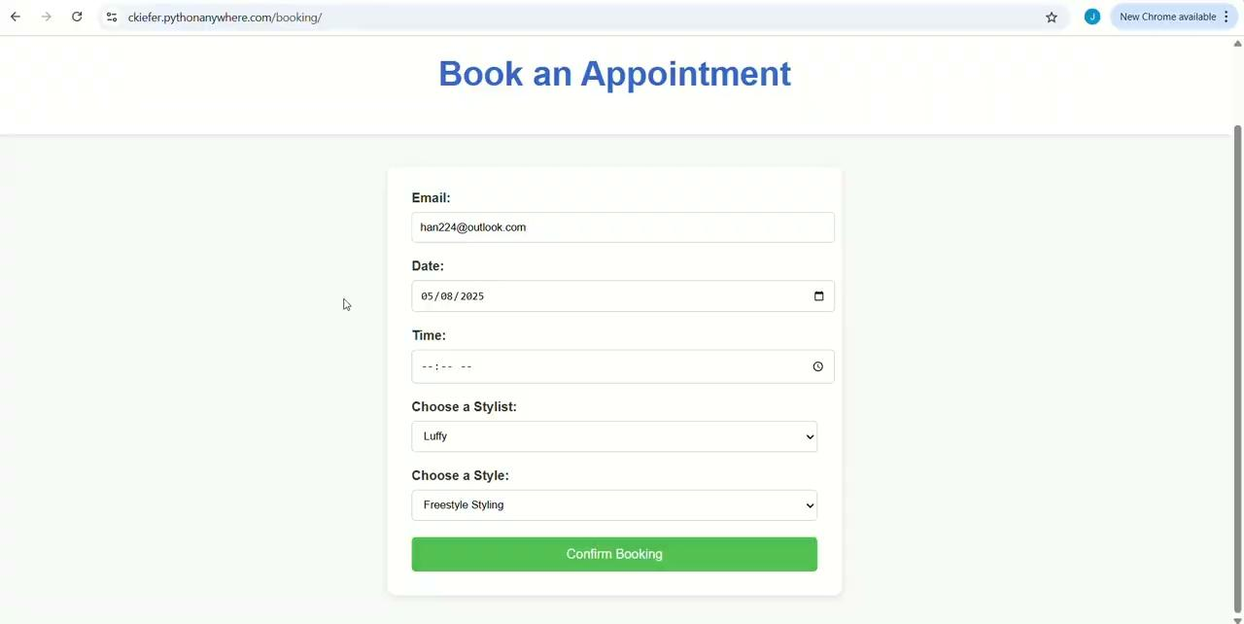
Test Log Six
Test Log Six:
Test with Time missing
Email: han224@outlook.com
Date: 5/8/25
Time:
Stylist: Luffy
Style: Freestyle Design Braids

Slide 8
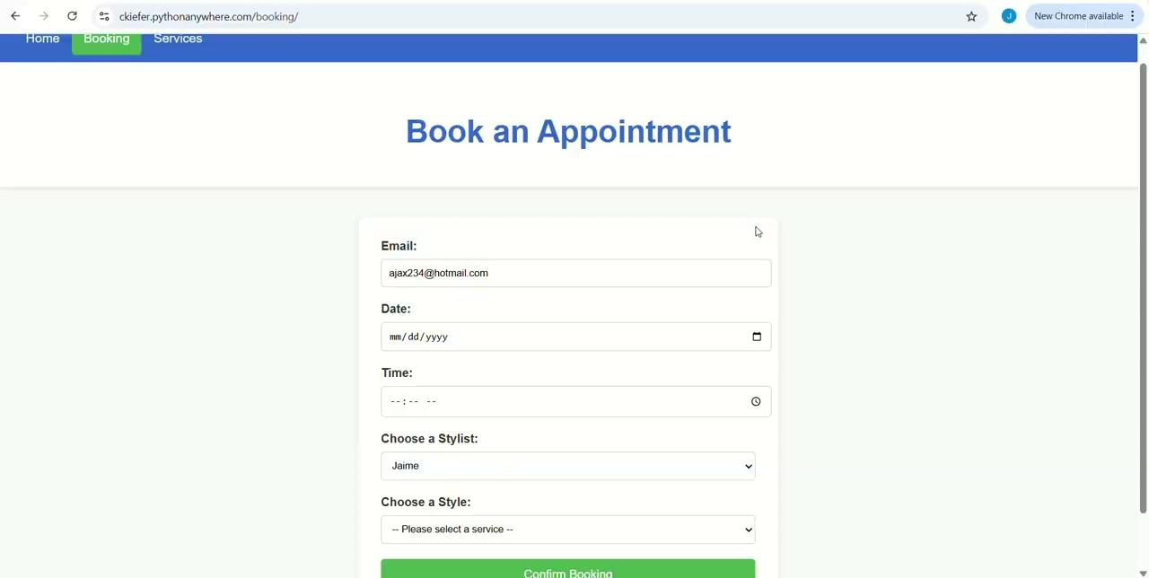
Test Log Seven
Test Log Seven:
Test with only email and stylist
Email:ajax234@hotmail.com
Date:
Time:
Stylist: Jamie
Style:

Slide 9
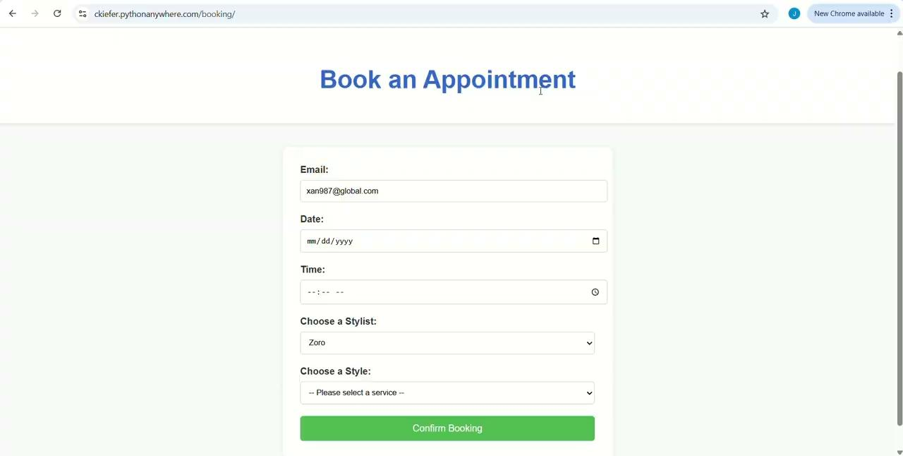
Test Log Eight
Test Log Eight:
Test Log with email and Stylist only
Email: xan987@globlal.com
Date:
Time:
Stylist: Zoro
Style:

Slide 10
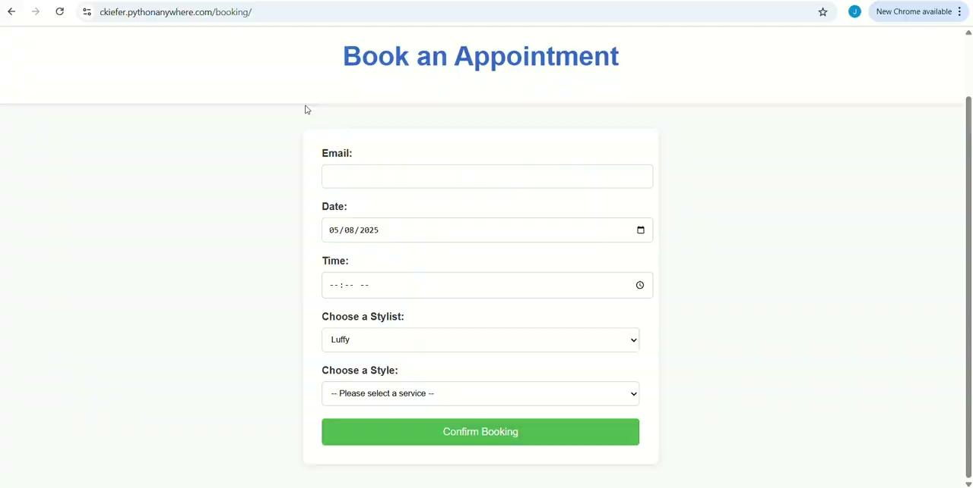
Test Log Nine
Test Log Nine:
Test with Date and Stylist
Email: trav22@msn.com
Date: 5/8/25
Time:
Stylist: Luffy
Style:

Slide 11
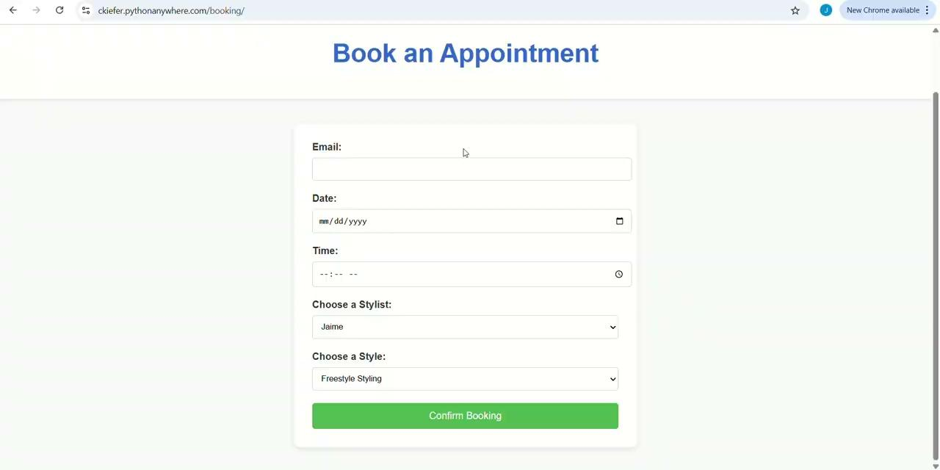
Test Log Ten
Test Log Ten:
Test Log with only Style and Stylist
Email:
Date:
Time:
Stylist: Jamie
Style: Freestyle Design Braids

Slide 12
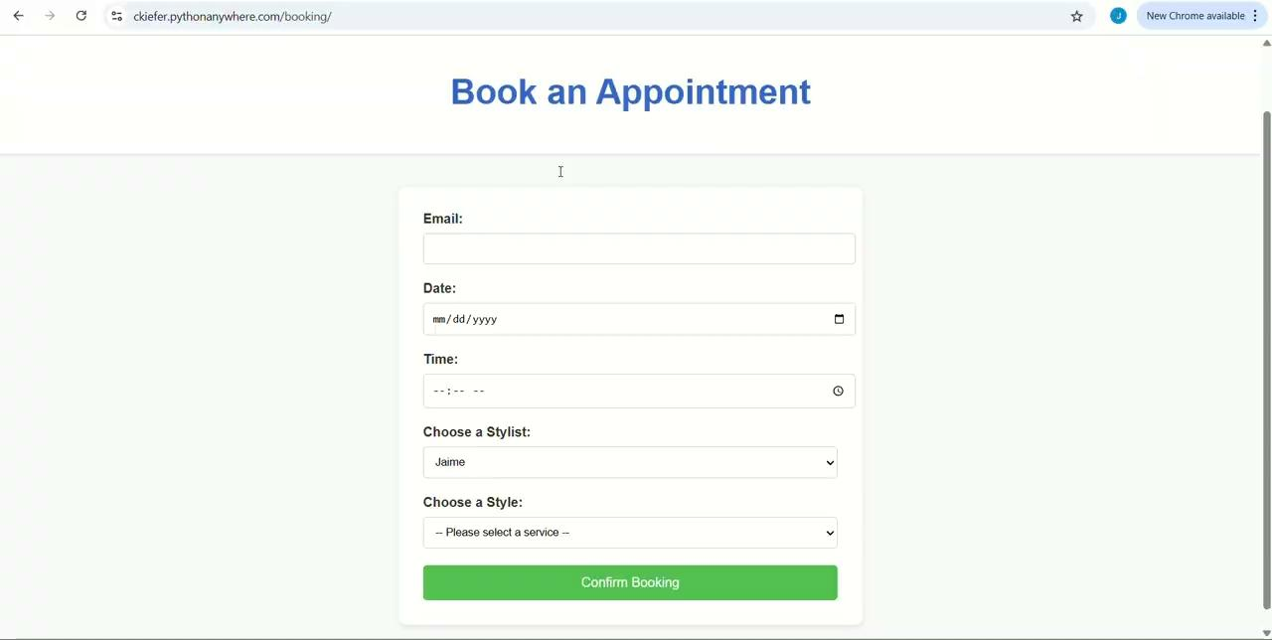
Test Log Eleven
Test Log Eleven:
Test log with all fields entered when prompted and only stylist pre-filled out
Email: miller5@gmail.net
Date: 5/8/25
Time: 11:00 AM
Stylist: Jamie
Style: Freestyle Design Braids

Slide 13
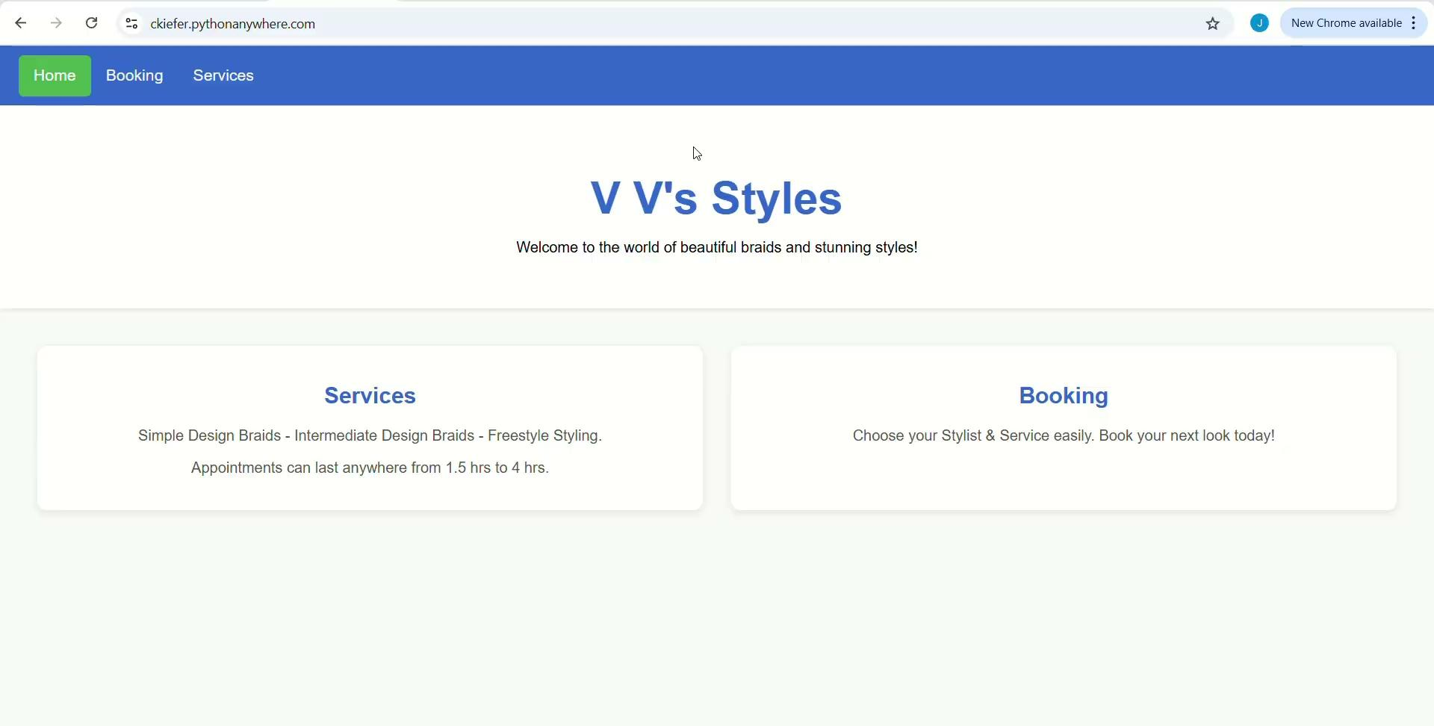
Test Log Twelve:
Test Log Twelve:
Test Log with all fields entered when prompted and only stylist field filled out
Email: blak4@outlook.com
Date: 5/8/2025
Time: 8:00 AM
Stylist: Jamie
Style: Simple Design Braids

Slide 14
Conclusion
The goal of the testing log is to show the system quality control. Along with that, the videos on the slides are there for proof that the system works as marketed and allows users to create appointments as long as they have the correct fields entered.
The test log has 12 logs, with one log to one side. Each log is labeled on its own slide, with the corresponding video. To the right of the video is a text box with the information used in the test log, as well as any parameters that are used for the test.
Logs 1 and 2 have all fields entered. Logs 3 through 6 have only one field missing. Logs 7 through 10 have only two fields filled out. Logs 11 and 12 start with only the stylist field entered and the rest of the fields are only entered once prompted by the program until the program allows the user to book the appointment.
The program will not allow a user to leave a field blank, so all the fields must be inputted before the program will allow the user to book an appointment.
Project Site Link: https://ckiefer.pythonanywhere.com/

